Slide 1


http://www.comp.nus.edu.sg/~cs2100/
Recitation-11
MIPS – Pipeline
Aaron Tan

Slide 2
Agenda
MIPS Pipeline Revision
Pipeline Hazards Revision
Quiz questions
Slido Q/A

Slide 3
MIPS Pipeline Revision

Slide 4
2. MIPS Pipeline Stages (1/2)
Five Execution Stages
IF: Instruction Fetch
ID: Instruction Decode and Register Read
EX: Execute an operation or calculate an address
MEM: Access an operand in data memory
WB: Write back the result into a register
Idea:
Each execution stage takes 1 clock cycle
General flow of data is from one stage to the next
Exceptions:
Update of PC and write back of register file – more about this later…

Slide 5
2. MIPS Pipeline Stages (2/2)

Slide 6
2. Pipelined Execution: Illustration
Time
IF
ID
EX
MEM
WB
IF
ID
EX
MEM
WB
IF
ID
EX
MEM
WB
IF
ID
EX
MEM
WB
Program Flow
(Instructions)
IF
ID
EX
MEM
WB
IF
ID
EX
MEM
WB
Several instructions are in the pipeline simultaneously!

Slide 7
3. MIPS Pipeline: Datapath (1/3)
Single-cycle implementation:
Update all state elements (PC, register file, data memory) at the end of a clock cycle
Pipelined implementation:
One cycle per pipeline stage
Data required for each stage needs to be stored separately (why?)

Slide 8
3. MIPS Pipeline: Datapath (2/3)
Data used by subsequent instructions:
Store in programmer-visible state elements: PC, register file and memory
Data used by same instruction in later pipeline stages:
Additional registers in datapath called pipeline registers
IF/ID: register between IF and ID
ID/EX: register between ID and EX
EX/MEM: register between EX and MEM
MEM/WB: register between MEM and WB
Why no register at the end of WB stage?

Slide 9
3. MIPS Pipeline: Datapath (3/3)
Coloured rectangles are pipeline registers

Slide 10
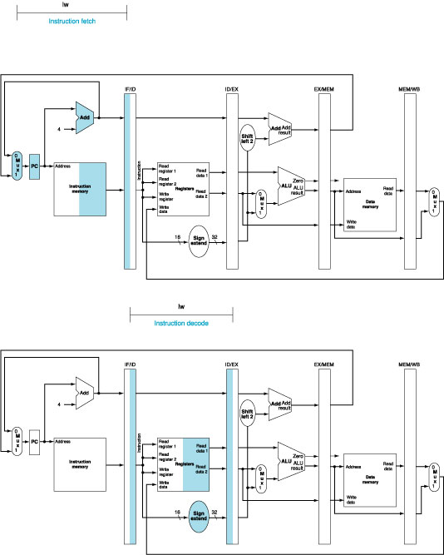
3. Pipeline Datapath: IF Stage
At the end of a cycle, IF/ID receives (stores):
Instruction read from InstructionMemory[ PC ]
PC + 4
PC + 4
Also connected to one of the MUX's inputs (another coming later)

Slide 11
3. Pipeline Datapath: ID Stage
At the beginning of a cycle IF/ID register supplies: | At the end of a cycle ID/EX receives:
Register numbers for reading two registers 16-bit offset to be sign-extended to 32-bit PC + 4 | Data values read from register file 32-bit immediate value PC + 4

Slide 12
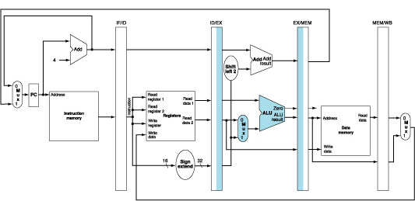
3. Pipeline Datapath: EX Stage
At the beginning of a cycle ID/EX register supplies: | At the end of a cycle EX/MEM receives:
Data values read from register file 32-bit immediate value PC + 4 | (PC + 4) + (Immediate x 4) ALU result isZero? signal Data Read 2 from register file

Slide 13
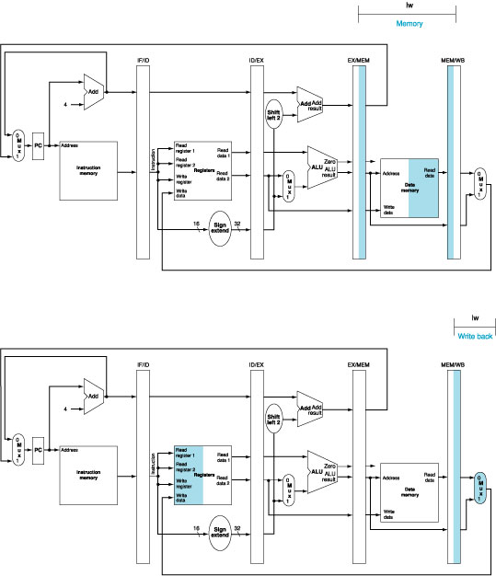
3. Pipeline Datapath: MEM Stage
At the beginning of a cycle EX/MEM register supplies: | At the end of a cycle MEM/WB receives:
(PC + 4) + (Immediate x 4) ALU result isZero? signal Data Read 2 from register file | ALU result Memory read data

Slide 14
3. Pipeline Datapath: WB Stage
At the beginning of a cycle MEM/WB register supplies: | At the end of a cycle
ALU result Memory read data | Result is written back to register file (if applicable) There is a bug here…….

Slide 15
3. Corrected Datapath (1/2)
Observe the “Write register” number
Supplied by the IF/ID pipeline register
It is NOT the correct write register for the instruction now in WB stage!
Solution:
Pass “Write register” number from ID/EX through EX/MEM to MEM/WB pipeline register for use in WB stage
i.e. let the "Write register" number follows the instruction through the pipeline until it is needed in WB stage

Slide 16
3. Corrected Datapath (2/2)

Slide 17
4. Pipeline Control: Main Idea
Same control signals as single-cycle datapath
Difference: Each control signal belongs to a particular pipeline stage

Slide 18
4. Pipeline Control: Grouping
Group control signals according to pipeline stage
 | RegDst | ALUSrc | MemToReg | Reg Write | Mem Read | Mem Write | Branch | ALUop
 |  |  |  |  |  |  |  | op1 | op0
R-type | 1 | 0 | 0 | 1 | 0 | 0 | 0 | 1 | 0
lw | 0 | 1 | 1 | 1 | 1 | 0 | 0 | 0 | 0
sw | X | 1 | X | 0 | 0 | 1 | 0 | 0 | 0
beq | X | 0 | X | 0 | 0 | 0 | 1 | 0 | 1
 | EX Stage |  |  |  | MEM Stage |  |  | WB Stage
 | RegDst | ALUSrc | ALUop |  | Mem Read | Mem Write | Branch | MemToReg | Reg Write
 |  |  | op1 | op0
R-type | 1 | 0 | 1 | 0 | 0 | 0 | 0 | 0 | 1
lw | 0 | 1 | 0 | 0 | 1 | 0 | 0 | 1 | 1
sw | X | 1 | 0 | 0 | 0 | 1 | 0 | X | 0
beq | X | 0 | 0 | 1 | 0 | 0 | 1 | X | 0

Slide 19
4. Pipeline Control: Implementation
Signal used in EX stage and onwards
Signal generated in ID stage
Signal propagated along until utilized

Slide 20
4. Pipeline Control: Datapath and Control

Slide 21
Ideal Pipeline (i.e., No Hazards)
 |  |  | F | D | E | M | W
 |  |  |  | F | D | E | M | W
 |  |  |  |  | F | D | E | M | W
 |  |  |  |  |  | F | D | E | M | W
 |  |  |  |  |  |  | F | D | E | M | W
 |  |  |  |  |  |  |  | F | D | E | M | W
 |  |  |  |  |  |  |  |  | F | D | E | M | W
 |  |  |  |  |  |  |  |  |  | F | D | E | M | W
 | F | D | E | M | W
 |  | F | D | E | M | W
 | 1 | 2 | 3 | 4 | 5 | 6 | 7 | 8 | 9 | 10 | 11 | 12 | 13 | 14
Instr-1
Instr-2
Instr-3
Instr-4
Instr-5
Instr-6
Instr-7
Instr-8
Instr-9
Instr-10
Number of cycles required = 14 cycles
I = No. of instructions.
N = No. of pipeline stages.
No. of cycles = I + (N – 1).

Slide 22
Pipeline Hazards Revision

Slide 23
Pipeline Hazards
3 types of pipeline hazards
Structural hazards
Data hazards
Control hazards

Slide 24
2. Structural Hazard: Example
If there is only a single memory module:
Time (clock cycles)
Load and Inst3 access memory in the same cycle!
Load
Mem
Reg
ALU
Mem
Reg
Inst1
Mem
Reg
ALU
Mem
Reg
Instruction Order
Inst2
Mem
Reg
ALU
Mem
Reg
Inst3
Mem
Reg
ALU
Mem
Reg

Slide 25
2. Structural Hazard: Stalling the Pipeline?
Time (clock cycles)
Load
Mem
Reg
ALU
Mem
Reg
Not a solution!
Inst1
Mem
Reg
ALU
Mem
Reg
Inst2
Mem
Reg
ALU
Mem
Reg
Instruction Order
Stall
Bubble
Bubble
Bubble
Bubble
Bubble
Inst3
Delay (Stall) Inst3 for
1 cycle
Mem
Reg
ALU
Mem
Reg

Slide 26
2. Structural Hazard: Separate Memory
Split memory into Data and Instruction memory
Time (clock cycles)
Load uses Data Memory
Load
Mem
Reg
ALU
Mem
Reg
Inst1
Mem
Reg
ALU
Mem
Reg
Instruction Order
Inst2
Mem
Reg
ALU
Mem
Reg
Inst3
Mem
Reg
ALU
Mem
Reg
Inst3 uses Instr. Memory

Slide 27
2. Structural Hazard: Is there another conflict?
Time (clock cycles)
Inst0 and Inst3 are accessing the Register File in the same cycle. What if both access the same register?
Inst0
Mem
Reg
ALU
Mem
Reg
Inst1
Mem
Reg
ALU
Mem
Reg
Instruction Order
Inst2
Mem
Reg
ALU
Mem
Reg
Inst3
Mem
Reg
ALU
Mem
Reg

Slide 28
2. Structural Hazard: Is there another conflict?
Recall that registers are very fast memory.
Solution: Split cycle into half; first half for writing into a register; second half for reading from a register.
Time (clock cycles)
Inst0 writes into the register during the first half of the cycle.
Inst0
Mem
Reg
ALU
Mem
Reg
Inst1
Mem
Reg
ALU
Mem
Reg
Instruction Order
Inst2
Mem
Reg
ALU
Mem
Reg
Inst3
Mem
Reg
ALU
Mem
Reg
Inst3 reads from the register during the second half of the cycle.

Slide 29
4. RAW Data Hazards
Value from prior instruction is needed before write back
T
i
m
e
(
i
n
c
l
o
c
k
c
y
c
l
e
s
)
V
a
l
u
e
o
f
C
C
1
C
C
2
C
C
3
C
C
4
C
C
5
C
C
6
C
C
7
C
C
8
C
C
9
r
e
g
i
s
t
e
r
$
2
:
1
0
1
0
1
0
1
0
1
0
/
–
2
0
–
2
0
–
2
0
–
2
0
–
2
0
s
u
b
$
2
,
$
1
,
$
3
I
M
R
e
g
D
M
R
e
g
Data
dependency
No problem
a
n
d
$
1
2
,
$
2
,
$
5
I
M
R
e
g
D
M
R
e
g
o
r
$
1
3
,
$
6
,
$
2
I
M
R
e
g
D
M
R
e
g
a
d
d
$
1
4
,
$
2
,
$
2
I
M
R
e
g
D
M
R
e
g
s
w
$
1
5
,
1
0
0
(
$
2
)
I
M
R
e
g
D
M
R
e
g

Slide 30
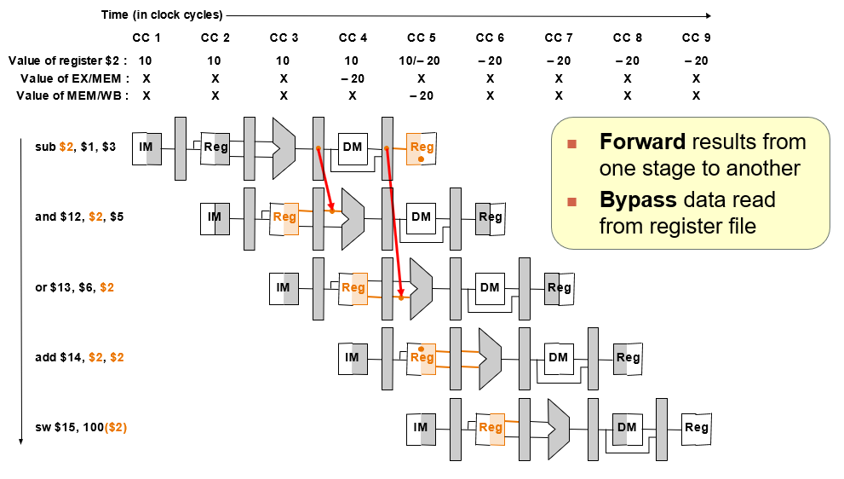
Data Hazards: Forwarding technique (1/2)

Slide 31
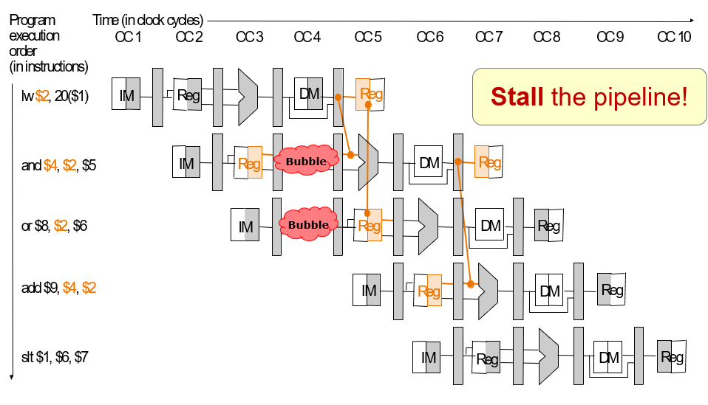
Data Hazards: Forwarding technique (2/2)
Forwarding removes all delay, except for lw (why?)
With forwarding, there is still 1 cycle of delay for the instruction after lw.

Slide 32
5. Control Dependency: Why?
Decision is made in MEM stage:
Too late!

Slide 33
5. Control Dependency: Example
P
r
o
g
r
a
m
T
i
m
e
(
i
n
c
l
o
c
k
c
y
c
l
e
s
)
e
x
e
c
u
t
i
o
n
C
C
1
C
C
2
C
C
3
C
C
4
C
C
5
C
C
6
C
C
7
C
C
8
C
C
9
o
r
d
e
r
Wrong
Execution!
(
i
n
i
n
s
t
r
u
c
t
i
o
n
s
)
4
0
b
e
q
$
1
,
$
3
,
7
I
M
R
e
g
D
M
R
e
g
4
4
a
n
d
$
1
2
,
$
2
,
$
5
I
M
R
e
g
D
M
R
e
g
4
8
o
r
$
1
3
,
$
6
,
$
2
I
M
R
e
g
D
M
R
e
g
5
2
a
d
d
$
1
4
,
$
2
,
$
2
I
M
R
e
g
D
M
R
e
g
7
2
l
w
$
4
,
5
0
(
$
7
)
I
M
R
e
g
D
M
R
e
g

Slide 34
6. Control Hazards: Stall Pipeline?
P
r
o
g
r
a
m
T
i
m
e
(
i
n
c
l
o
c
k
c
y
c
l
e
s
)
e
x
e
c
u
t
i
o
n
C
C
1
C
C
2
C
C
3
C
C
4
C
C
5
C
C
6
C
C
7
C
C
8
C
C
9
o
r
d
e
r
(
i
n
i
n
s
t
r
u
c
t
i
o
n
s
)
4
0
b
e
q
$
1
,
$
3
,
7
I
M
R
e
g
D
M
R
e
g
Bubble
Bubble
Bubble
Bubble
Bubble
Bubble
Bubble
Bubble
Bubble
Bubble
Bubble
Bubble
Bubble
Bubble
Bubble
7
2
l
w
$
4
,
5
0
(
$
7
)
I
M
R
e
g
D
M
R
e
g
Wait until the branch outcome is known and then fetch the correct instructions
➔ Introduces 3 clock cycles delay

Slide 35
Control Hazards
Techniques to reduce stalls:
Early Branching resolution
Move branch decision calculation to earlier pipeline stage
Branch Prediction
Guess the outcome of the branch
Delayed Branching
Do something useful while waiting for the outcome

Slide 36
Control Hazards: Early Branching
Branch resolution made at stage 2 (ID stage)
Branch target
address calculation
PC + 4
Target address
Shift
left 2
Add
4
ALUcontrol
Read
register 1
Read
data 1
Read
register 2
To branch
Control logic
Instruction
ALU
Zero
Write
register
Register File
ALU
result
Write
data
Read
data 2
RegWrite
Sign
extend
Register Comparison
16
32

Slide 37
6.1 Reduce Stalls: Early Branch (3/3)
P
r
o
g
r
a
m
T
i
m
e
(
i
n
c
l
o
c
k
c
y
c
l
e
s
)
e
x
e
c
u
t
i
o
n
C
C
1
C
C
2
C
C
3
C
C
4
C
C
5
C
C
6
C
C
7
C
C
8
C
C
9
o
r
d
e
r
(
i
n
i
n
s
t
r
u
c
t
i
o
n
s
)
4
0
b
e
q
$
1
,
$
3
,
7
I
M
R
e
g
D
M
R
e
g
Bubble
Bubble
Bubble
Bubble
Bubble
7
2
l
w
$
4
,
5
0
(
$
7
)
I
M
R
e
g
D
M
R
e
g
Wait until the branch decision is known:
Then fetch the correct instruction
Reduced from 3 to 1 clock cycle delay

Slide 38
6.1 Early Branch: Problems (1/3)
However, if the register(s) involved in the comparison is produced by preceding instruction:
Further stall is still needed!
T
i
m
e
(
i
n
c
l
o
c
k
c
y
c
l
e
s
)
P
r
o
g
r
a
m
C
C
1
C
C
2
C
C
3
C
C
4
C
C
5
C
C
6
C
C
7
C
C
8
C
C
9
e
x
e
c
u
t
i
o
n
o
r
d
e
r
(
i
n
i
n
s
t
r
u
c
t
i
o
n
s
)
$s0 is needed before it is produced!
add $s0, $s1, $s2
I
M
R
e
g
D
M
R
e
g
beq $s0, $s3, Exit
I
M
R
e
g
D
M
R
e
g
Bubble
I
M
R
e
g
D
M
R
e
g

Slide 39
6.1 Early Branch: Problems (2/3)
Solution:
Add forwarding path from ALU to ID stage
One clock cycle delay is still needed
T
i
m
e
(
i
n
c
l
o
c
k
c
y
c
l
e
s
)
P
r
o
g
r
a
m
C
C
1
C
C
2
C
C
3
C
C
4
C
C
5
C
C
6
C
C
7
C
C
8
C
C
9
e
x
e
c
u
t
i
o
n
o
r
d
e
r
(
i
n
i
n
s
t
r
u
c
t
i
o
n
s
)
add $s0, $s1, $s2
I
M
R
e
g
D
M
R
e
g
beq $s0, $s3, Exit
I
M
Bubble
R
e
g
D
M
R
e
g
Bubble
I
M
R
e
g
D
M
R
e
g

Slide 40
6.1 Early Branch: Problems (3/3)
Problem is worse with load followed by branch
Solution:
MEM to ID forwarding and 2 more stall cycles!
In this case, we ended up with 3 total stall cycles ➔ no improvement!
T
i
m
e
(
i
n
c
l
o
c
k
c
y
c
l
e
s
)
P
r
o
g
r
a
m
C
C
1
C
C
2
C
C
3
C
C
4
C
C
5
C
C
6
C
C
7
C
C
8
C
C
9
e
x
e
c
u
t
i
o
n
o
r
d
e
r
ALU ➔ ID forwarding cannot help!
(
i
n
i
n
s
t
r
u
c
t
i
o
n
s
)
lw $s0, 0($s1)
I
M
R
e
g
D
M
R
e
g
beq $s0, $s3, Exit
I
M
Bubble
Bubble
R
e
g
D
M
R
e
g
Bubble
I
M
R
e
g
D
M
R
e
g

Slide 41
6.2 Reduce Stalls: Branch Prediction
There are many branch prediction schemes
We only cover the simplest in this course ☺
Simple prediction:
All branches are assumed to be not taken
Fetch the successor instruction and start pumping it through the pipeline stages
When the actual branch outcome is known:
Not taken: Guessed correctly ➔ No pipeline stall
Taken: Guessed wrongly ➔ Wrong instructions in the pipeline ➔ Flush successor instruction from the pipeline

Slide 42
6.2 Branch Prediction: Correct Prediction
T
i
m
e
(
i
n
c
l
o
c
k
c
y
c
l
e
s
)
P
r
o
g
r
a
m
C
C
1
C
C
2
C
C
3
C
C
4
C
C
5
C
C
6
C
C
7
C
C
8
C
C
9
e
x
e
c
u
t
i
o
n
o
r
d
e
r
(
i
n
i
n
s
t
r
u
c
t
i
o
n
s
)
4
0
b
e
q
$
1
,
$
3
,
7
I
M
R
e
g
D
M
R
e
g
4
4
a
n
d
$
1
2
,
$
2
,
$
5
I
M
R
e
g
D
M
R
e
g
4
8
o
r
$
1
3
,
$
6
,
$
2
I
M
R
e
g
D
M
R
e
g
5
2
a
d
d
$
1
4
,
$
2
,
$
2
Branch is known to be not taken in cycle 3
➔ no stall needed!

Slide 43
6.2 Branch Prediction: Wrong Prediction
T
i
m
e
(
i
n
c
l
o
c
k
c
y
c
l
e
s
)
P
r
o
g
r
a
m
C
C
1
C
C
2
C
C
3
C
C
4
C
C
5
C
C
6
C
C
7
C
C
8
C
C
9
e
x
e
c
u
t
i
o
n
o
r
d
e
r
(
i
n
i
n
s
t
r
u
c
t
i
o
n
s
)
4
0
b
e
q
$
1
,
$
3
,
7
I
M
R
e
g
D
M
R
e
g
4
4
a
n
d
$
1
2
,
$
2
,
$
5
I
M
Bubble
Bubble
Bubble
Bubble
7
2
l
w
$
4
,
5
0
(
$
7
)
I
M
R
e
g
D
M
R
e
g
Branch is known to be taken in cycle 3
"and" instruction should not be executed
➔ Flushed from pipeline

Slide 44
6.3 Reduce Stalls: Delayed Branch
Observation:
Branch outcome takes X number of cycles to be known
X cycles stall
Idea:
Move non-control dependent instructions into the X slots following a branch
Known as the branch-delay slot
These instructions are executed regardless of the branch outcome
In our MIPS processor:
Branch-Delay slot = 1 (with the early branch)

Slide 45
6.3 Delayed Branch: Example
Non-delayed branch
or $8, $9, $10
add $1, $2, $3
sub $4, $5, $6
beq $1, $4, Exit
xor $10, $1, $11
Exit:
Delayed branch
add $1, $2, $3
sub $4, $5, $6
beq $1, $4, Exit
or $8, $9, $10
xor $10, $1, $11
Exit:
The "or" instruction is moved into the delayed slot:
Get executed regardless of the branch outcome
➔ Same behavior as the original code!

Slide 46
6.3 Delayed Branch: Observation
Best case scenario
There is an instruction preceding the branch which can be moved into the delayed slot
Program correctness must be preserved!
Worst case scenario
Such instruction cannot be found
➔ Add a no-op (nop) instruction in the branch-delay slot
Re-ordering instructions is a common method of program optimization
Compiler must be smart enough to do this
Usually can find such an instruction at least 50% of the time

Slide 47
QUIZ Questions

Slide 48
Week 11 Quiz Question 1
Let’s say there are 6 stages in executing an instruction and there are 10 instructions in a program. Each stage takes 1 clock cycle to execute. How many clock cycles are needed to complete the execution of this program in an ideal pipeline?
I = no. of instructions
N = no. of pipeline stages
I + N – 1 = 10 + 6 – 1 = 15 cycles

Slide 49
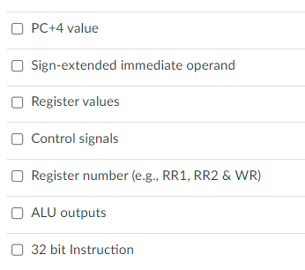
Week 11 Quiz Question 2
Pipeline register can store which of the following?
✓
✓
✓
✓
✓
✓
✓

Slide 50
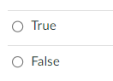
Week 11 Quiz Question 3
Each of the pipeline registers contains multiple registers of size 32 bits?
✓

Slide 51
Week 11 Quiz Question 4
The MIPS processor that we discussed in this course can execute at most 4 instructions simultaneously in an ideal pipeline.
✓

Slide 52
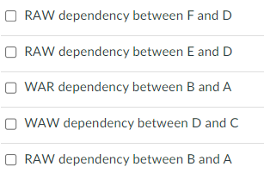
Week 11 Quiz Question 5
Below is a sequence of instructions A to F:
Which of the following are true with respect to RAW, WAR and WAW data dependency?
A. lw $t2, 0($t1)
B. lw $t1, 100($t6)
C. sub $t6, $t1, $t2
D. add $t6, $t2, $t6
E. and $t3, $t6, $0
F. sw $t6, 50($t1)
✓
✓
✓
✓

Slide 53
Week 11 Quiz Question 6
How many cycles are needed to execute this program with and without forwarding?
Without forwarding:
16 cycles
A. lw $t2, 0($t1)
B. lw $t1, 100($t6)
C. sub $t6, $t1, $t2
D. add $t6, $t2, $t6
E. and $t3, $t6, $0
F. sw $t6, 50($t1)
 | 1 | 2 | 3 | 4 | 5 | 6 | 7 | 8 | 9 | 10 | 11 | 12 | 13 | 14 | 15 | 16
lw | F | D | E | M | W
lw
sub
add
and
sw
F D E M W
F D E M W
F D E M W
F D E M W
F D E M W
 | 1 | 2 | 3 | 4 | 5 | 6 | 7 | 8 | 9 | 10 | 11 | 12 | 13 | 14 | 15 | 16
lw | F | D | E | M | W
lw
sub
add
and
sw
With forwarding:
11 cycles
F D E M W
F D E M W
F D E M W
F D E M W
F D E M W

Slide 54
Week 11 Quiz Question 7
How many cycles are needed to execute this program with forwarding, assume branch-taken prediction strategy, branch decision made at MEM, whereas the actual branch in the code is taken.
lw $s2, 0($s1)
bne $s2, $s3, L1
sub $s0, $s4, $s5
L1: add $s0, $s0, $s3
 | 1 | 2 | 3 | 4 | 5 | 6 | 7 | 8 | 9 | 10 | 11 | 12
lw | F | D | E | M | W
bne
add
F D E M W
F D E M W
8 cycles

Slide 55
Week 11 Quiz Question 8
How many cycles are needed to execute this program with forwarding, assume branch-NOT-taken prediction strategy, branch decision made at MEM, whereas the actual branch in the code is taken.
lw $s2, 0($s1)
bne $s2, $s3, L1
sub $s0, $s4, $s5
L1: add $s0, $s0, $s3
 | 1 | 2 | 3 | 4 | 5 | 6 | 7 | 8 | 9 | 10 | 11 | 12
lw | F | D | E | M | W
bne
sub
add
add
F D E M W
F D E M W
F D E M W
F D E M W
11 cycles

Slide 56
Slido Q/A

Slide 57
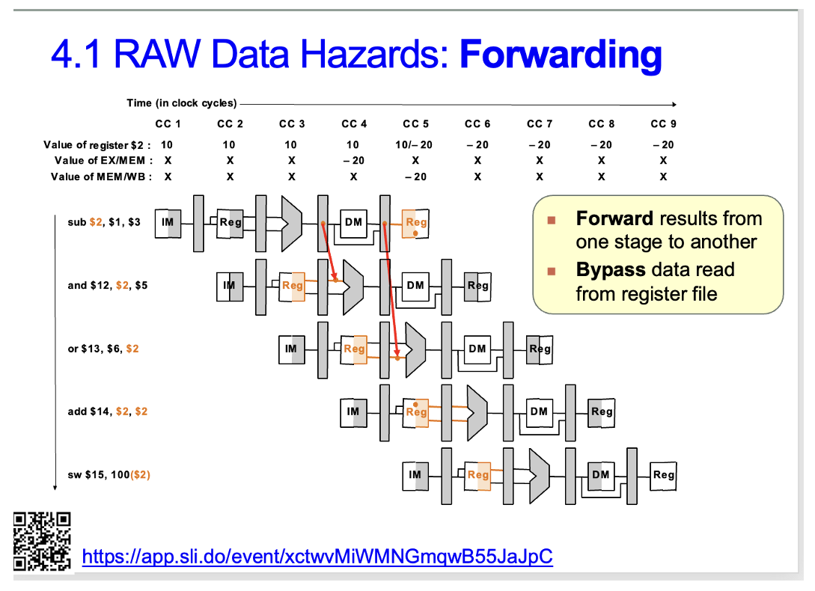
Slido Questions
Why is the MEM/WB pipeline register used to forward data to the OR instruction instead of EX/MEM like the AND instruction before it on slide 17 of Lecture 21?

Slide 58
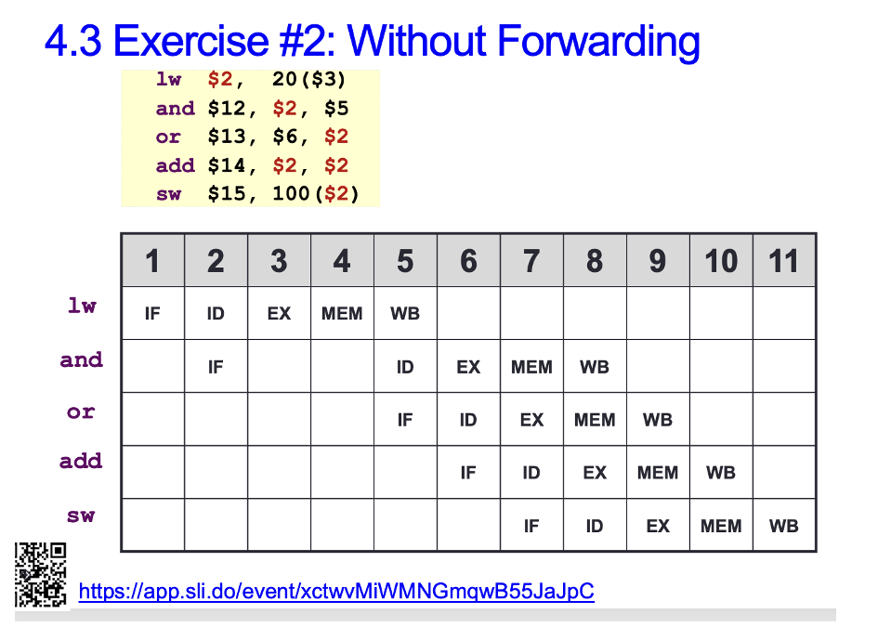
Slido Questions
In Lecture 21 Slide 24, why is the IF stage for the OR instruction in clock cycle 5? Can it not be at clock cycle 3?

Slide 59
End of File

